Slide 1



MA-4240
Applied Statistics
(Course Project Report)
Music and Mental Health Engagement Survey

Slide 2
GROUP MEMBERES
Ashwini Bhavsar- MA22MSCST11017@IITH.AC.IN
Neelam - MA22MSCST11011@IITH.AC.IN
Saurabh Bhoi - MA22MSCST11014@IITH.AC.IN
Ashok Kumar - MA22MSCST11007@IITH.AC.IN
Deepak Kumar - MA22MSCST11008@IITH.AC.IN
Dishanta Bharali - MA22MSCST11013@IITH.AC.IN
Ravi Kumar - MA22MSCST11005@IITH.AC.IN
Ibrahim Parekh- MA22MSCST11010@IITH.AC.IN
Yasaswini Nasaka - MA22MSCST11006@IITH.AC.IN

Slide 3
CONTENTS
S.No | Contents
1 | INTRODUCTION
2 | DATA COLLECTION
3 | SUMMARISING AND VISUALIZING DATA
4 | ANALYZING THE EFFECT OF MUSIC ON MENTAL HEALTH
5 | CONFIDENCE INTERVAL ESTIMATOR
6 6.1 6.2 | HYPOTHESIS TESTING Rejection Region Approach P-value Approach
7 | SUMMARY
8 | TEAM MEMBER CONTRIBUTION

Slide 4
1. INTRODUCTION
Welcome to our music survey project! Music is a universal language that transcends cultural and generational boundaries. As college students, we understand the importance of music in our lives. Whether it's studying for exams, relaxing after a long day, or jamming out with friends, music has a significant impact on our mood and overall well-being. That's why we are conducting a survey to better understand the musical preferences and listening habits of our fellow college students.
By collecting data and analyzing the results, we aim to gain insights into the diverse musical tastes, trends, and behaviors of our peers. We believe that this project will not only provide valuable information but also foster a deeper appreciation for the power of music in our college community. Join us as we embark on this exciting journey to explore the wonderful world of music among college students! So, let's dive in and explore the rhythm of your musical world!

Slide 5
2. DATA COLLECTION
We performed experimental study using self-administered questionnaire where we circulated a google form among IITH students.
Our variable of interests are as follows:-
>How often do you listen to music?
>What genre of music do you usually listen to?
>At what time of the day do you like listening to music?
>In what ways do you think listening to music helps your mental health?
The method we used for data collection is a non-probabilistic method i.e. Gathering Volunteers, where we have circulated the survey form.
Our data set contains responses from 321 students.

Slide 6
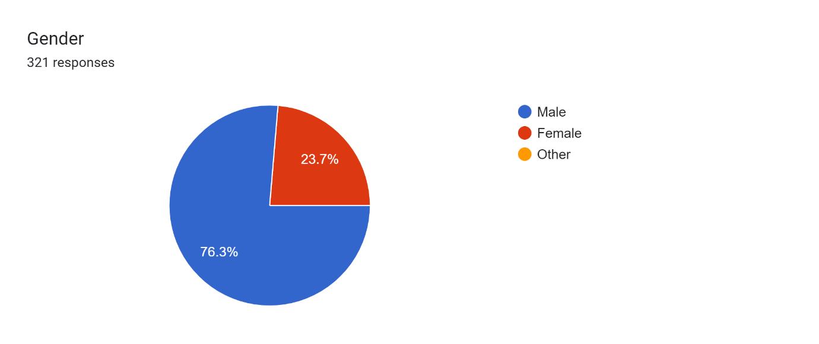
3. SUMMARISING AND VISUALIZING DATA
Total responses 321 responses
Male – 76.3% (245)
Female – 23.7% (76)

Slide 7
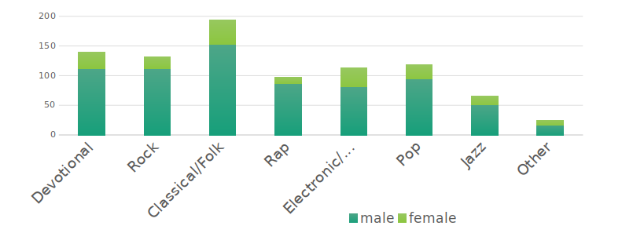
Genre preferred by the students (segmented bar chart)
From the above Bar Chart we can clearly see that out of all the genres Classical/Folk is the most preferred whereas the second least preferred genre is jazz and the least preferred is other genres.

Slide 8
Genre preferred by male vs female (pie chart)
The most preferred genre in both male and female is Classical/Folk.
Second preference for male is Devotional (16%) and Rock (16%) whereas among female the second preference is Devotional.

Slide 9
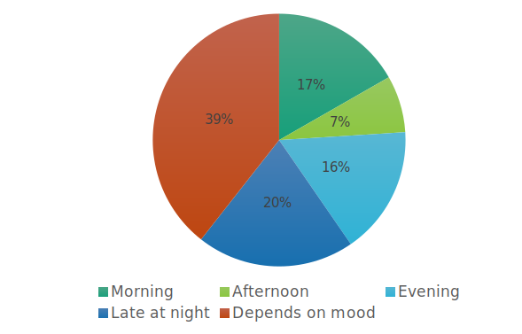
When do they prefer to listen music
Most of the students listen to music according to their mood (Instead of having a routine).
So it’s safe to say that listening to songs have impact on students mentally.

Slide 10
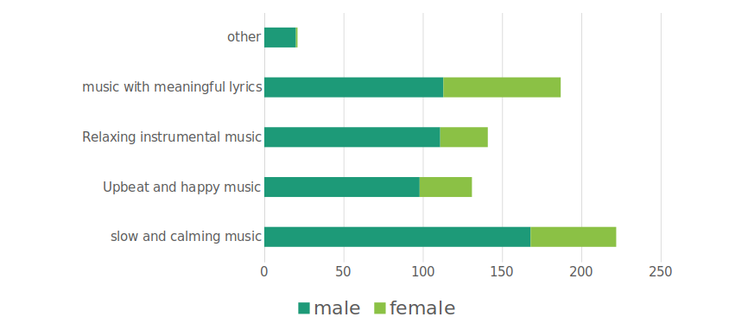
Type of music that puts them in a good mood (segmented bar chart)
4. ANALYZING THE EFFECT OF MUSIC ON MENTAL HEALTH
Slow and Calming music is preferred by most of the students when they feel low.
Individually among male the most preferred type is slow and calming music.
Whereas in female songs with meaningful lyrics usually puts them in a good.

Slide 11
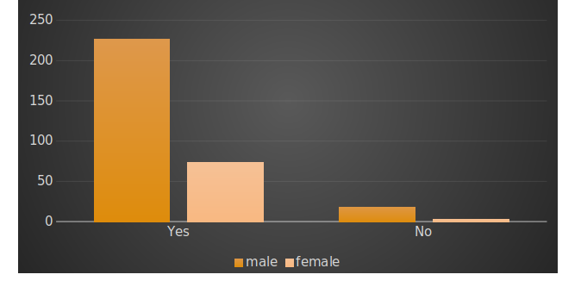
Have you ever felt listening to music has an impact on your mental health?
Most of the students have felt that listening to music has impacted their mental health

Slide 12
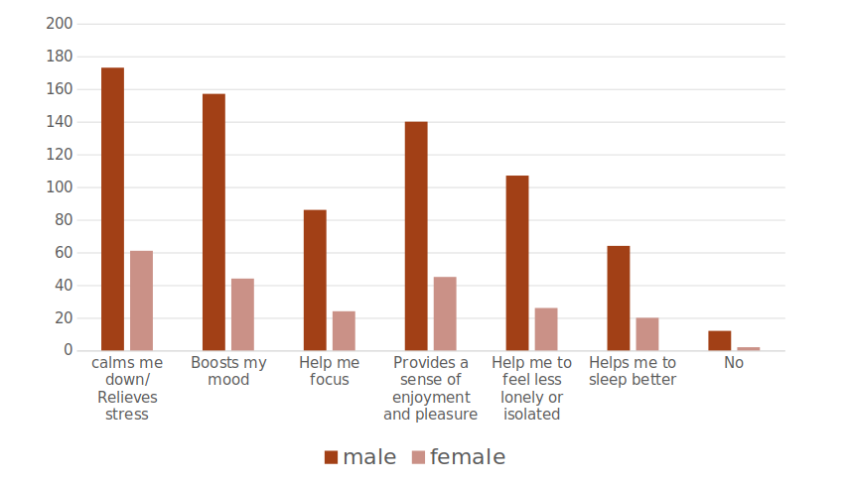
In what ways did listening to music helped their mental health
For most of the male and female listening to songs usually calms them down/ helped them with stress

Slide 13
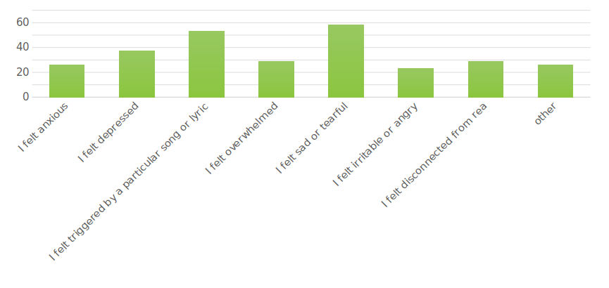
How did listening to music sometimes had a negative impact on their mood?
Students had negative impacts on their mood while listening to music like Feeling sad/ tearful (being the most common reason) and feeling triggered by a particular song/lyrics (second most common reason).

Slide 14
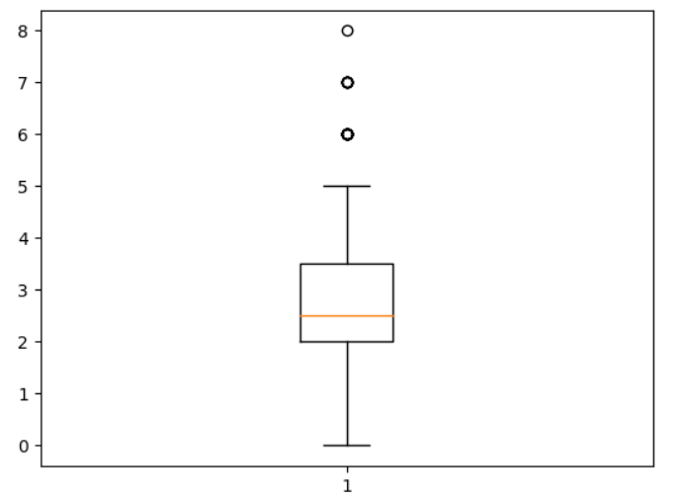
Box plot on average number of hours spent listening to music. The median is 2.5 hrs whereas maximum and minimum hrs is 5 and 0 respectively. The box plot also contains 6,7 and 8 hrs as outliers.
 | AVERAGE TIME SPENT ON LISTENING MUSIC PER DAY(hrs)
Count | 321.000000
Mean | 2.641745
Std | 1.524078
Min | 0.000000
Q1 (25%) | 2.000000
Q2 (Median) | 2.500000
Q3 (75%) | 3.500000
Max | 5.000000
Max =5
Q3=3.5
Q2=2.5
Q1=2
Min = 0

Slide 15
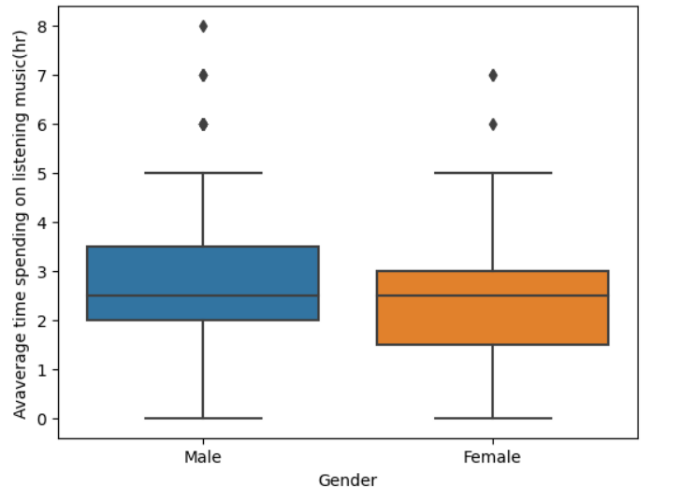
Average time in hours per day spent listening to music (side by side box plot)
MALE
ATTRIBUTES | VALUE
Max | 5
Q3 | 3.5
Median | 2.5
Q1 | 2
Min | 0
FEMALE
ATTRIBUTES | VALUE
Max | 5
Q3 | 3
Median | 2.5
Q1 | 1.5
Min | 0

Slide 16
Average time spent listening to music (per day)
GENDER | AVERAGE TIME SPENT LISTENING TO MUSIC (hrs)
 | COUNT | MEAN | STD | MIN | 25% | 50% | 75% | MAX
FEMALE | 76.0 | 2.513158 | 1.346536 | 0.0 | 1.5 | 2.5 | 3.0 | 5.0
MALE | 245.0 | 2.681633 | 1.575514 | 0.0 | 2.0 | 2.5 | 3.5 | 5.0
Even though the mean listening time of male and female is almost the same the standard deviation is more for male when compared to female.

Slide 17
 | GENDER | WHAT GENRE DO YOU USUALLY LISTEN TO | WHEN DO YOU USUALLY LISTEN SONGS | HAVE YOU EVER FELT LISTENING TO MUSIC HAS A POSITIVE IMPACT ON YOUR MOOD | IN WHAT WAYS DID LISTENING TO MUSIC HELPED WITH YOUR MENTAL HEALTH | WHAT KIND OF MUSIC USUALLY HELPS YOU FEEL BETTER | HAVE YOU EVER EXPERIENCED A NEGATIVE IMPACT ON YOUR MOOD WHILE LISTENING MUSIC | IF YES, HOW DID IT EFFECT YOU
COUNT | 321 | 321 | 321 | 321 | 321 | 321 | 321 | 321
UNIQUE | 2 | 104 | 24 | 2 | 52 | 19 | 2 | 60
TOP | Male | Classical/ Folk | Depends on mood | Yes | Calms me down/ Relieves Stress, boosts my mood, helps me focus, makes me feel less lonely, helps me sleep better, provides a sense of enjoyment | Slow and Calming music | No, I never had any negative impact | I felt triggered while listening to a particular song
FREQ | 245 | 29 | 128 | 300 | 29 | 40 | 218 | 17

Slide 18
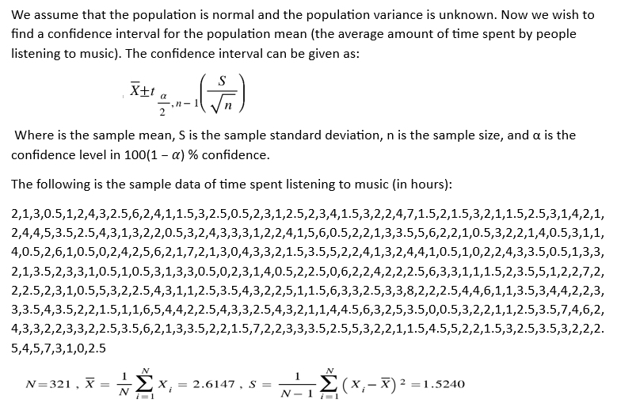
5. CONFIDENCE INTERVAL ESTIMATOR

Slide 19
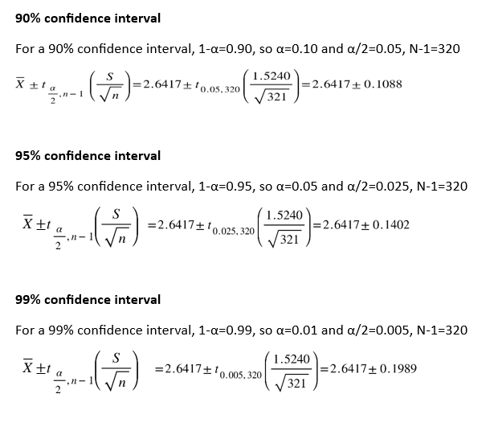

Slide 20
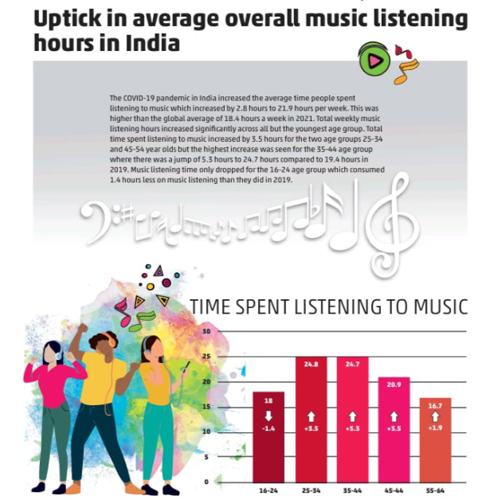
6. HYPOTHESIS TESTING
Following are the hypothesis that we constructed:
Hₒ: µ >= 3.1286
Hₐ: µ < 3.1286
i.e. We are considering the null hypothesis as the number of hours students of IITH listen to music is greater than or equal to 3.1286, and the alternate hypothesis to be the number of hours is less than 3.1286

Slide 21
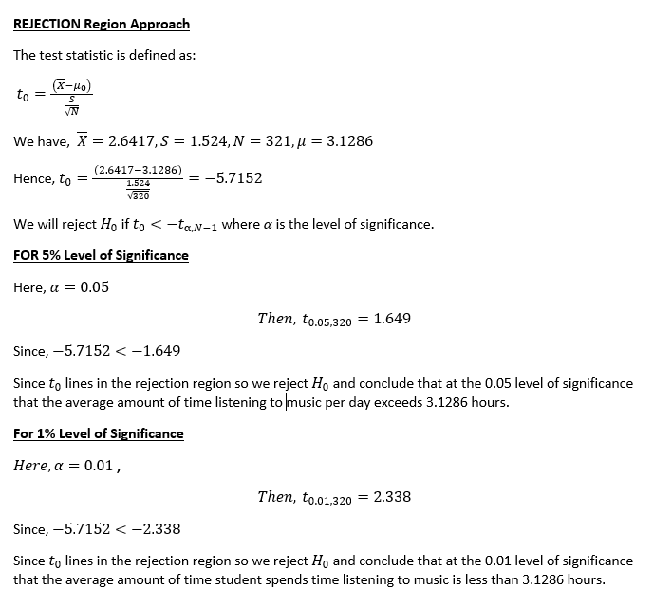
6.1 Rejection Region Approach

Slide 22
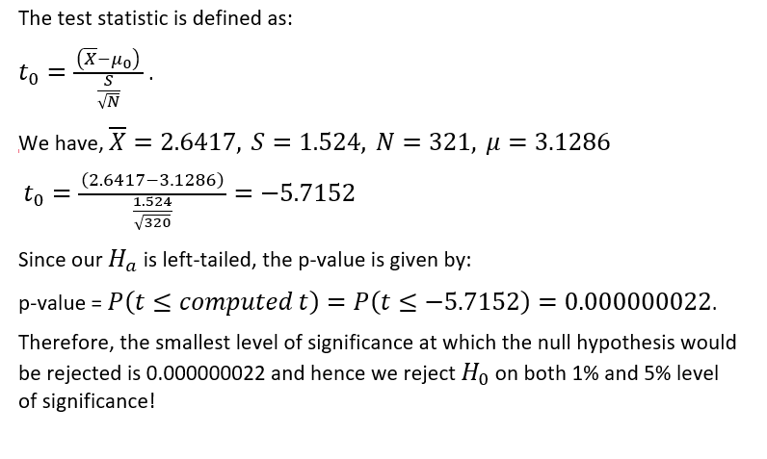
6.2 p-values approach

Slide 23
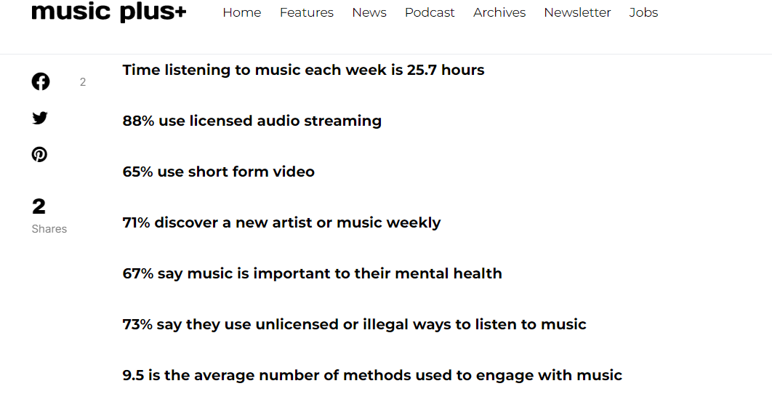
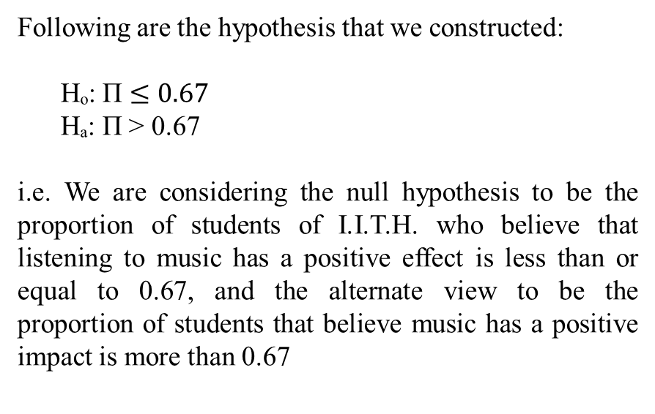
7. HYPOTHESIS TESTING
Following are the hypothesis that we constructed:
Hₒ: Π $≤0.67$
Hₐ: Π > 0.67
i.e. We are considering the null hypothesis to be the proportion of students of I.I.T.H. who believe that listening to music has a positive effect is less than or equal to 0.67, and the alternate view to be the proportion of students that believe music has a positive impact is more than 0.67

Slide 24
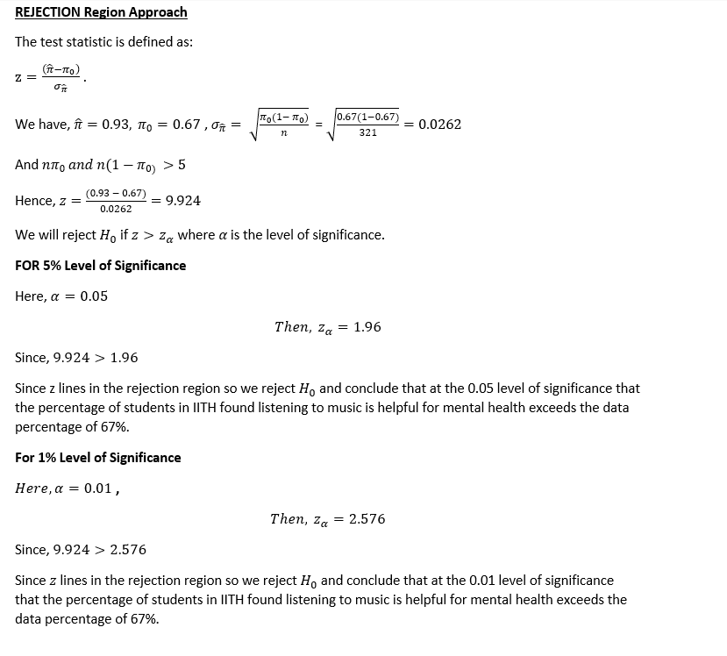
7.1 REJECTION REGION APPROACH

Slide 25
7. SUMMARY
In this Project, we were mainly interested to know about the benefits of listening to music and how music plays an important role in the student community of IITH. It also focuses on the effects on the mental health of the IITH student community and also how much time they spend listening to music.
For data collection, we used a self-administered questionnaire and a non-probabilistic method.
For summarizing and visualizing data, we used pie charts, histograms and bar graphs.
RESULTS
We also constructed box plots and side-by-side box plots of the average time spent listening to music to observe if there were any skewness. We saw that in the box plot in which we took the whole student community, the box plot was right skewed, and the side-by-side box plot of male and female students showed us that the box plot with male students had right skewness. In contrast, the female students have left skewness, from which we inferred that female students spend more time listening to music than male students.
We did hypothesis testing about the mean to determine if the average time spent by IITH students listening to music was less than that of a young Indian student, which was 3.12 hours per week(that we took from a survey from I.M.I.). We could reject the null hypothesis that the average time spent by IITH students listening to music was more than 3.12 hours. So we could conclude that the average of an IITH student is less than that of a young Indian student.
We also did a hypothesis testing about proportion to determine if the ratio of students that believe music affects mental health is more than the global average of 67%(according to a report by Musicplus). We considered the null hypothesis to be that the number of students who believe music does not positively affect mental health is less than 67%. We were able to able to reject the null hypothesis. So, we conclude that students who believe music positively affect mental health more than 67%.

Slide 26
8. TEAM MEMBER CONTRIBUTION
Ashok Kumar & Deepak Kumar & Ibrahim Parekh
Collection of Data sets by conducting a survey and adding questions to the study.
Neelam & Ashwini Bhavsar
Cleaning data set/plotting the graphs and charts from the survey data set.
Ravi Kumar & Yasaswini Nasaka
In concluding the graph, Pi charts, box plots etc., report preparation.
4. Dishanta Bharali & Saurabh Bhoi
Hypothesis testing and confidence interval

